Slide 1
Services & Service Territory
Utilities Kingston provides:
    Electricity to central Kingston (the “old” city)
    Gas to central Kingston (the “old” city)
    Water and sewer services to the entire city
    The former townships are provided electricity by Hydro One and gas by Union Gas
    LDC = local distribution company

Slide 2
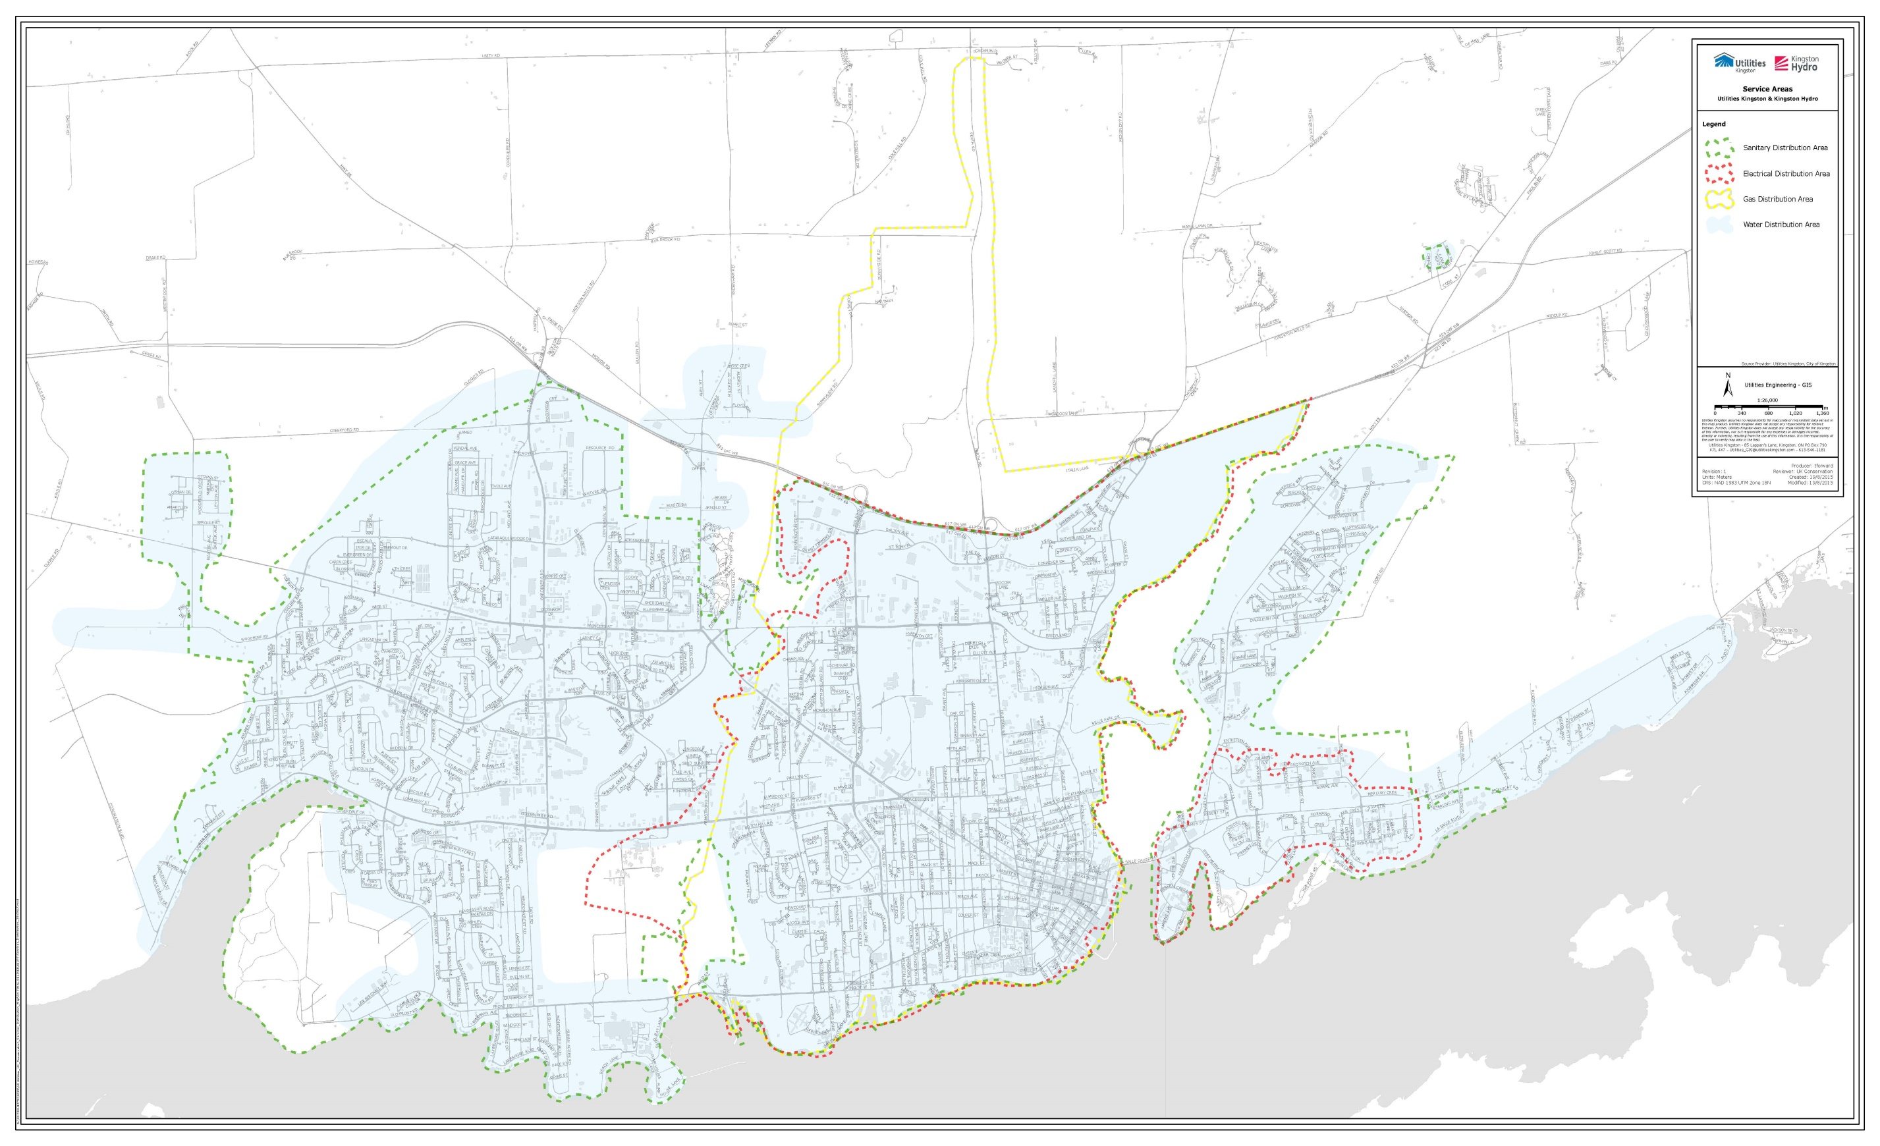

Slide 3
Conservation Targets
Provincial target of 7 TWh
Kingston Hydro target of 34.5 GWh by end of 2020
Thanks to our customers, we’re about 80% of the way there!

Slide 4
Save On Energy
Suite of provincially-offered (and some local ones) programs designed for utilities to use to achieve their conservation targets
Commercial and residential programs available

Slide 5
Residential Programs
Home Assistance Program
Affordability Fund Trust
Heating and Cooling Incentive
Deal Days

Slide 6
Home Assistance Program
Income-qualifying program
Open to tenants and home owners (not high-rise residents)
Free home energy audit
Free energy conservation measures:
  LED light bulbs
  Appliances
  Insulation

Slide 7
Affordability Fund Trust
Similar to Home Assistance Program, in that it’s free measures for residential customers
Based on electricity affordability burden
Can be a mailed kit, or up to appliance replacements
www.affordabilityfund.org
1-855-494-FUND(3863)

Slide 8
Heating and Cooling Incentive
Must go through a registered contractor
$250 for high-efficiency furnace
$600 for ENERGY STAR central air conditioner

Slide 9
Deal Days
In-store discounts:
  LED bulbs
  Weatherstripping
  Laundry drying racks
  Happen once each year, in the fall

Slide 10
Commercial Programs
Audit Funding
Small Business Lighting
Business Refrigeration Incentive
Process and Systems Upgrade
High Performance New Construction
Energy Manager
Retrofit

Slide 11
Audit Funding
Electricity survey and analysis (whole building)
Systems audit (just one system in a building, excluding lighting)
Incentive is lesser of calculation based on square footage, or 50% of the audit cost

Slide 12
Small Business Lighting
Eligible business can get up to $2,000 in free lighting
An assessor visits the business and determines eligible measures
Equipment is installed by selected contractor

Slide 13
Business Refrigeration Incentive
Very similar to Small Business Lighting
Up to $2,500 in free refrigeration upgrades
  Night curtains
  Strip curtains for walk-in coolers and freezers
  Condenser cleaning

Slide 14
Process and Systems Upgrade
For larger projects, with savings of 300MWh or more
Can include study funding (Engineering Feasibility Study)
For projects like large chiller replacements, server replacements, or co-generation (not natural gas-fired cogen)

Slide 15
High Performance New Construction
Rewards building owners for the construction of efficient buildings
Incentive is based on kWh savings
Money available for energy model, as well as for the design decision maker

Slide 16
Energy Manager
Funding available to install a dedicated energy manager at a facility (or group of facilities)
Salary or performance-based
Savings target of 2,000kWh/year or 1,000kWh, depending on track
Required to be CET, C.Tech., CEM, or P.Eng, with “strong background in energy management”

Slide 17
Retrofit
Program pays based on either kWh savings or a per-measure basis
ANYTHING that saves electricity is eligible for funding (lights, motors, pumps, fans, etc.)

Slide 18
Prescriptive track
Incentive on a per-measure basis
i.e. $3.50/A19 LED

Slide 19
Most measures have specific requirements:
  LED lights must be Design Lights Consortium (DLC) listed or ENERGY STAR rated
  Unitary AC has minimum energy efficiency ratio (EER) requirements
  The system on which a variable frequency drive is to be installed must run a minimum of 2,000 hours per year

Slide 20
Custom track
$0.05/kWh for lighting projects, $0.10/kWh for non-lighting projects
May not seem like a lot, but incentives routinely reach thousands of dollars.
Requires runtime of equipment and before and after specs to calculate incentive

Slide 22
Water conservation incentives
$5/m³ saved, minimum of 80m³ savings, covering up to 20% of project costs
Once-through water-cooled equipment – potential for significant water conservation incentive
Can be coupled with electricity and gas incentives

Slide 23
Toilet rebate program
$30 per toilet for replacement of toilets that use 13 Litres per flush (Lpf) or more with single-flush toilets of 4.8Lpf flush or less, or dual-flush toilets with a maximum flush volume of 6Lpf
$30 per toilet for replacement of toilets that use 6Lpf with single-flush toilets that use 3Lpf or less
$60 per toilet for replacement of toilets that use 13Lpf with single-flush toilets that use 3Lpf or less

Slide 24
As with Retrofit, it’s important to apply before the work is done
Quick, one-page application form
https://utilitieskingston.com/Water/Conservation/

Slide 25
Gas conservation incentives
Condensing boilers, furnaces, and hot water heaters each have prescriptive incentives; these incentives are based on the size of the equipment
$0.10/m3 of gas saved, minimum $100 incentive (unless coupled with other incentives)

Slide 26
Application must be submitted prior to work being done
Quick, one-page application form

Slide 27
Caitlin Newey
Conservation Officer
(613)888-0149
(613)546-1181 ext. 3283
cnewey@utilitieskingston.com

