Slide 1
Rebuilding Canada for a healthier economic future
#onpoli
June 5, 2020

Slide 2
Presenter
Isabelle Turcotte
Federal director, Pembina Institute

Slide 3
Presenter
Carolyn Kim
Ontario director, Pembina Institute

Slide 4
Building a healthy, prosperous, low-carbon Canada
The Pembina Institute is a non-profit think-tank that advocates for strong, effective policies to support Canada's clean-energy transition.

Slide 5
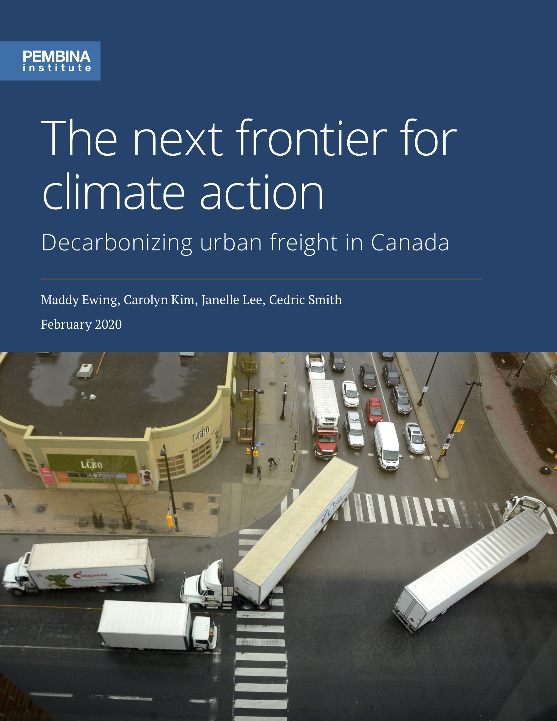
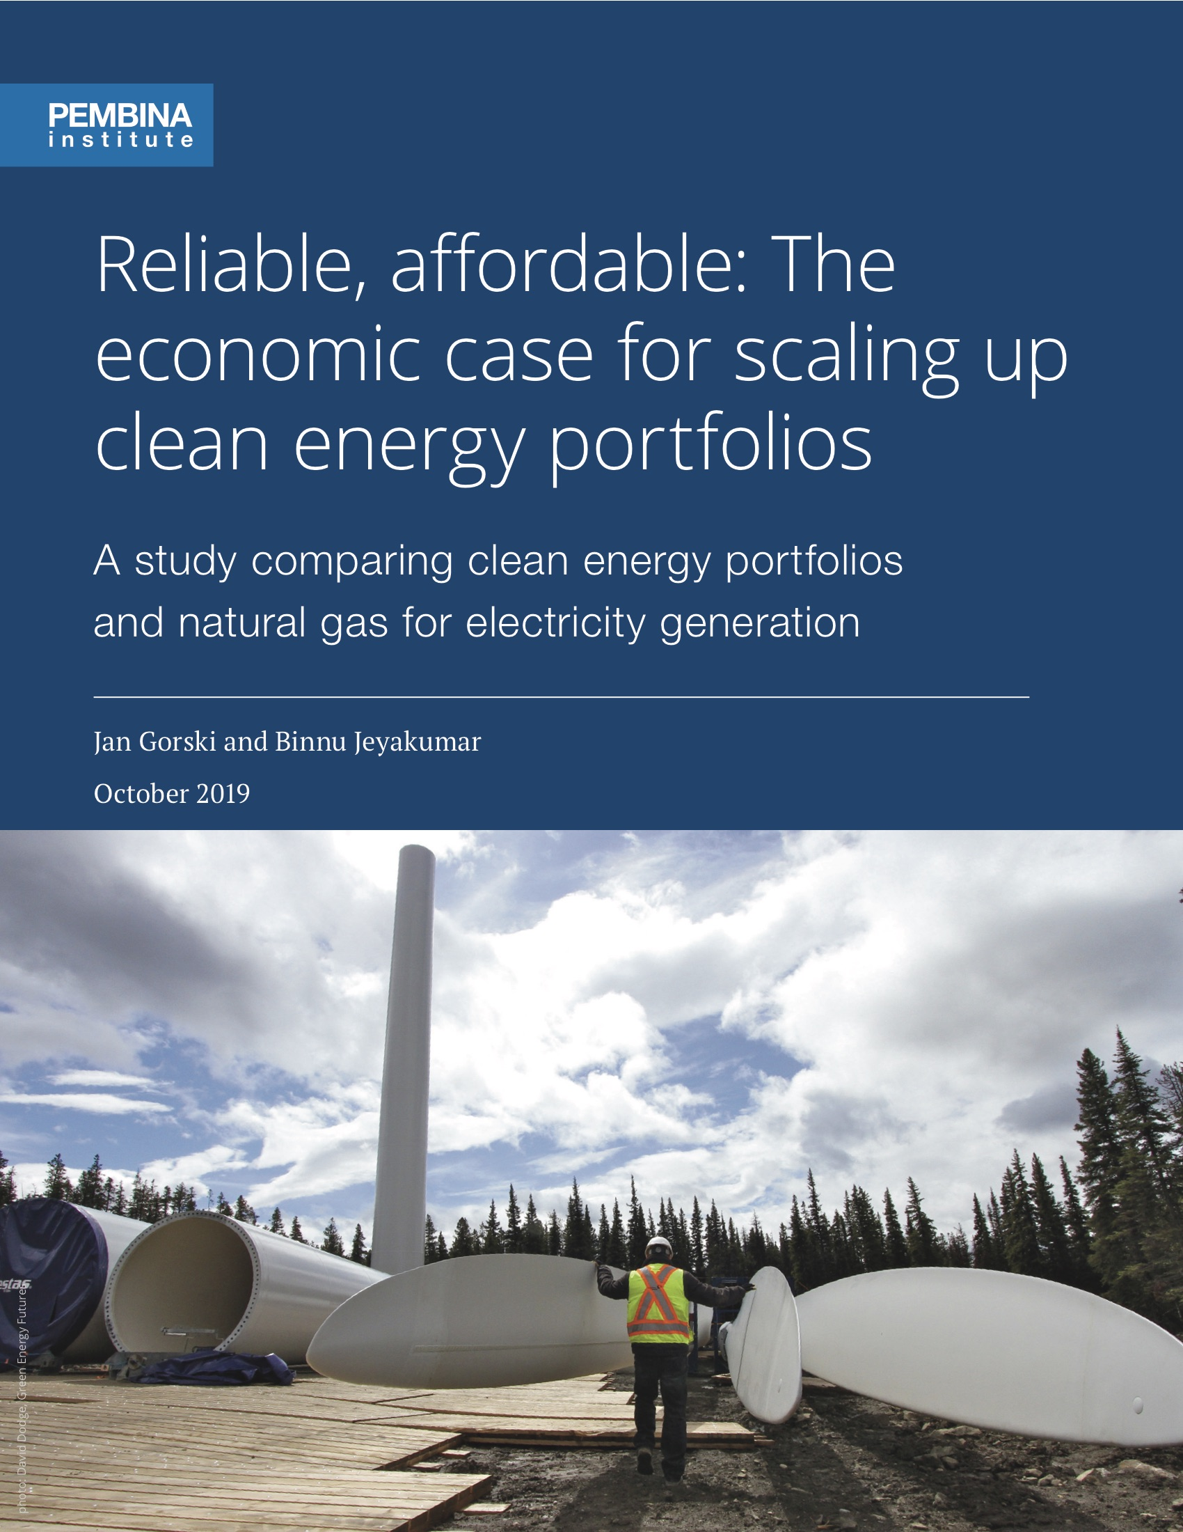
Some recent work

Slide 6
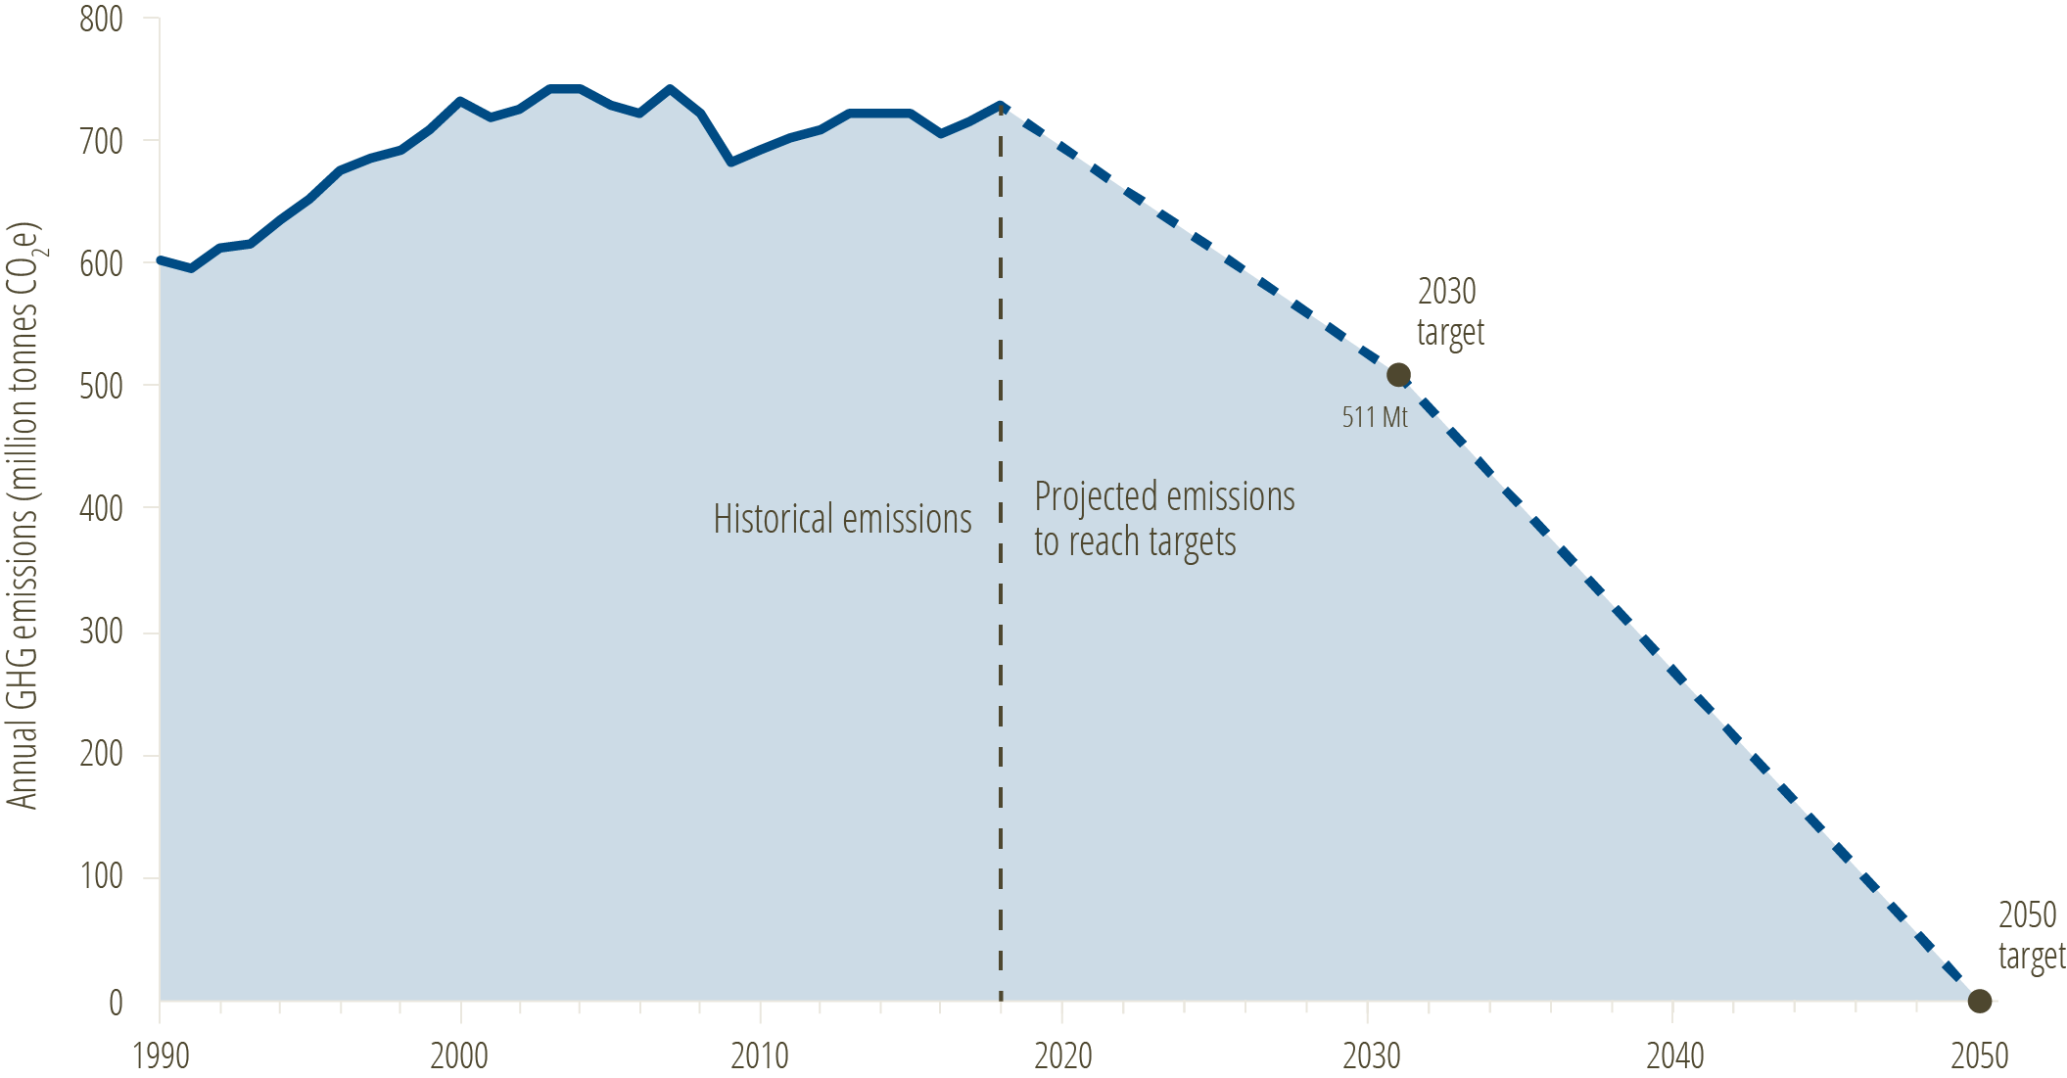
Flattening Canada's climate curve

Slide 7
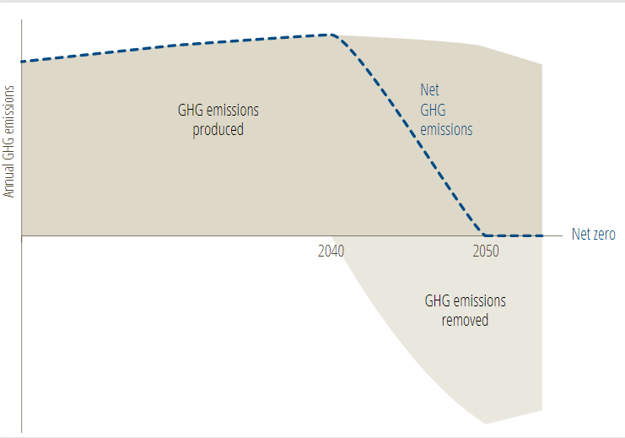
How we get there is more important than the journey

Slide 8
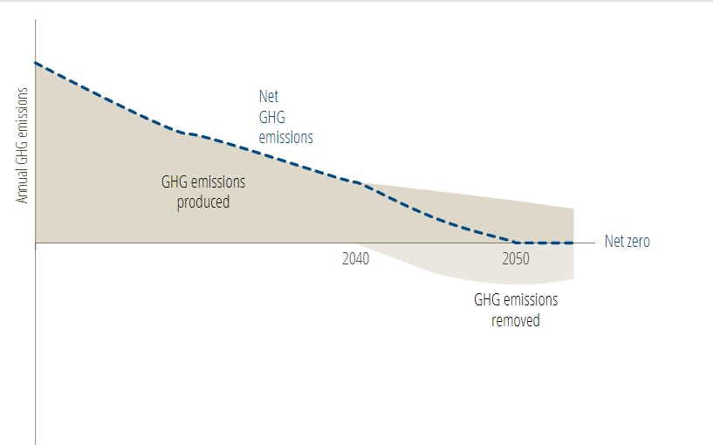
How we get there is more important than the journey

Slide 9
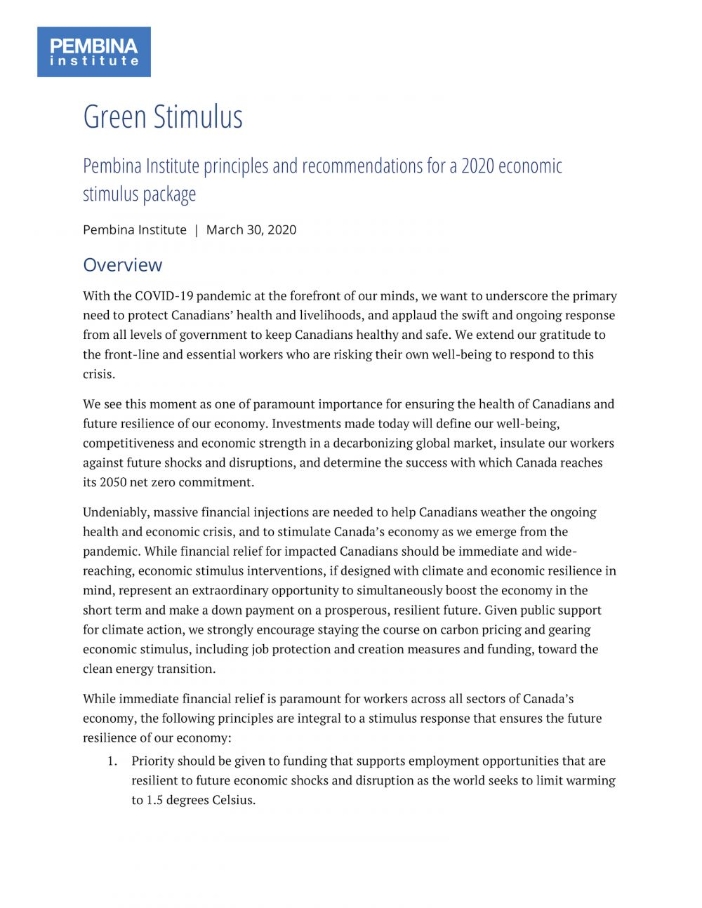
Rebuilding better
Boost economy in the short term
Build economic competitiveness
Protect workers against future shocks and disruptions

Slide 10
Guiding principles
Prioritize funding for jobs resilient to economic disruption in a world limiting warming to 1.5°C
Prioritize investment in industries producing low- or zero-carbon goods and services
Use investments in industry to incentivize decarbonization beyond existing regulatory requirements
Make stimulus decisions through the lens of meeting climate commitments

Slide 11
Key recommendations
Invest in training for careers in the low-carbon economy
Invest nationwide in deep retrofits to decarbonize homes and buildings
Invest in the deep decarbonization of Canada’s electricity system
Invest in the ZEV economy, clean fuels, and Canada's transit systems
Stay the course on carbon pricing

Slide 12
Social equity
Addressing our two biggest challenges: climate change and social inequity
Focus on diversification
Importance of depolarizing the conversation

Slide 13
Building retrofits
Buildings represent 13% of Canada’s carbon pollution
Deep retrofits are healthier, resilient, low-carbon
The opportunity is enormous … half of our building stock

Slide 14
Electrification
The importance of modernizing the grid

Slide 15
Transportation
Electrifying freight for health, market share
Advancing zero-emission commercial vehicles

Slide 16
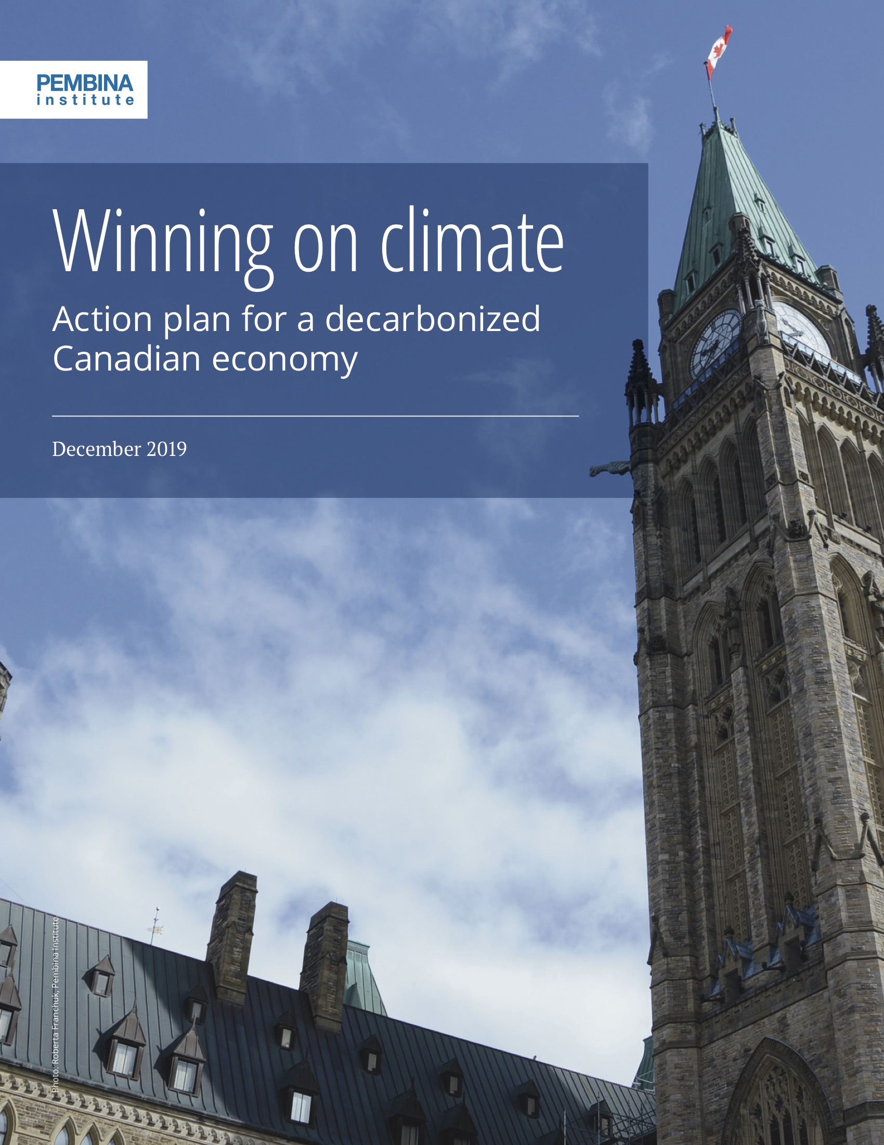
Staying the course on climate policy
Rebuilding efforts must be sustained and leveraged by robust energy and climate policy
Now it the time to design our pathways to 2050

Slide 17
Roundtable discussion
What are the barriers to solutions to transform the sectors?
How can we work with the Ontario and federal governments in their recovery plans?
What information do governments need? How can we be a resource?

